Slide 1
Image Morphological Operations Lec 14

Slide 2

Morphological Operations
Morphological operations come from the word “morphing” in Biology which means “changing a shape”.
Morphing

Slide 3

Morphological Operations
Originated from set operations
Can be used to manipulate object shapes such as thinning, thickening, filling, etc.

Slide 4
What is the mathematical morphology ?
An approach for processing digital image based on its shape
A mathematical tool for investigating geometric structure in image
The language of morphology is set theory

Slide 5
Introduction---Morphology Operations
Terminology
Morphology: a broad set of image processing operations that process images based on shapes.
Morphological operations apply a structuring elements to an input image, creating an output image of the same size.
Properties
Morphological operations simplify images, and quantify and preserve the main shape characteristics of objects.

Slide 6
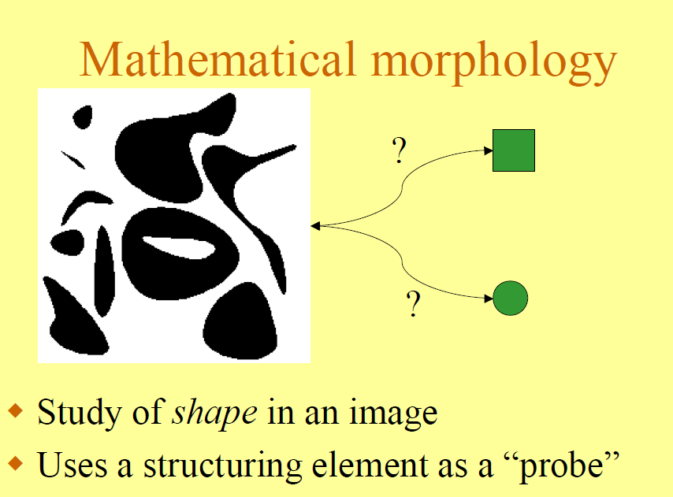

Slide 7
In general; what is “Morphology”?
The science of form and structure
the science of form, that of the outer form, inner structure, and development of living organisms and their parts
about changing/counting regions/shapes
Among other applications it is used to pre- or post-process images
via filtering, thinning and pruning
Count regions (granules)
number of black regions
Estimate size of regions
area calculations

Slide 8
What is Morphology in computer vision ?
Morphology generally concerned with shape and properties of objects.
Used for segmentation and feature extraction.
Segmentation = used for cleaning binary objects.
Two basic operations
erosion (opening)
dilation (closing)

Slide 9
Mathematical Morphology - Set-theoretic representation for binary shapes

Slide 10
Binary Morphology
Morphological operators are used to prepare binary (thresholded) images for object segmentation/recognition
Binary images often suffer from noise (specifically salt-and-pepper noise)
Binary regions also suffer from noise (isolated black pixels in a white region). Can also have cracks, picket fence occlusions, etc.
Dilation and erosion are two binary morphological operations that can assist with these problems.

Slide 11
Goals of morphological operations:
1. Simplifies image data
2. Preserves essential shape characteristics
3. Eliminates noise
4. Permits the underlying shape to be identified and optimally reconstructed from their distorted, noisy forms

Slide 12
Importance of Shape in Processing and Analysis
Shape is a prime carrier of information in machine vision
For instance, the following directly correlate with shape:
identification of objects
object features
assembly defects

Slide 13
Binary Morphology

Slide 14
Basic Concepts From Set theory

Slide 15
The Cross Product

Slide 16
Shape Operators
Shapes are usually combined by means of :
Set Union (overlapping objects):
Set Intersection (occluded objects):

Slide 17
Examples
A
A
A
B
B
B
A
A
B

Slide 18
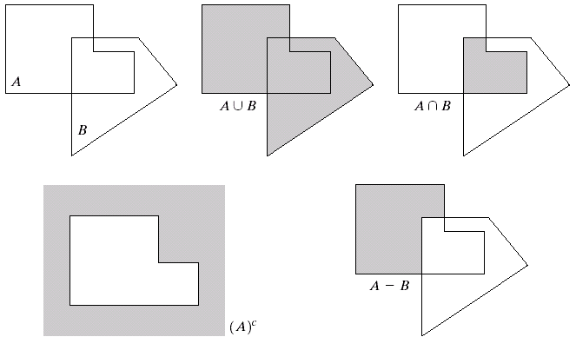
Basic Set Operations

Slide 19
Notation Specific To Morphological Processing

Slide 20
Translation and Reflection Operations
Reflection

Slide 21
Notation Specific To Morphological Processing

Slide 22
Translation and Reflection Operations
Translation
A
(A)_{z}

Slide 23
Morphological Operations based on combining basic operations
The primary morphological operations are dilation and erosion
More complicated morphological operators can be designed by means of combining erosions and dilations
We will use combinations of union, complement, intersection, erosion, dilation, translation...

Slide 24
Structuring element
Morphological operations can be customized for an application by the proper selection of the structuring element, which determines exactly how the object will be dilated or eroded.
matlab function strel() can create many kinds of structuring element:
dish-shaped,
diamond-shaped,
ball-shaped,
square
flat linear with length LEN
arbitrary flat or a nonflat with the specified neighborhood

Slide 25
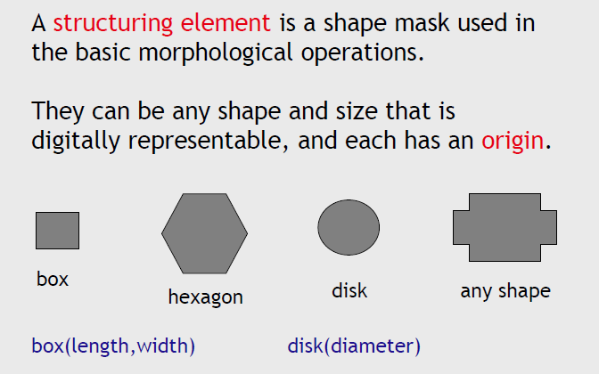
Libraries of Structuring Elements
Application specific structuring elements created by the user

Slide 26


Notation
x
-2 -1 0 1 2
-2 -1 0 1 2
B
y
A special set :
the structuring element
X
Origin at center in this case, but not necessarily centered nor symmetric
No necessarily compact
nor filled
3*3 structuring element, see next slide how it works

Slide 27
Dilation

Slide 28
Dilation
Dilation allows objects to expand, then potentially filling in small holes and connecting disjoint object.
Performance: laying the structuring element on the image and sliding it across the image.
1) If the origin of the structuring element coincides with a ‘0’ in the image, there is no change; move to the next pixel.
2) If the origin of the structuring element coincides with a ‘1’ in the images, perform the OR logic operation on all pixels within the structuring element.

Slide 29
Dilation
Dilation is the operation that combines two sets using vector addition of set elements.
Let A and B are subsets in 2-D space.
A: image undergoing analysis,
B: Structuring element,

Slide 30
Summary effects of dilation:
Expand/enlarge objects in the image
Fill gaps or bays of insufficient width
Fill small holes of sufficiently small size
Connects objects separated by a distance less than the size of the window

Slide 31
Dilation
B
A

Slide 32
Dilation

Slide 33
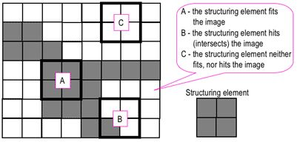
The structuring element is positioned at all possible locations in the image and it is compared with the corresponding neighbourhood of pixels. Some operations test whether the element "fits" within the neighbourhood, while others test whether it "hits" or “miss”

Slide 34
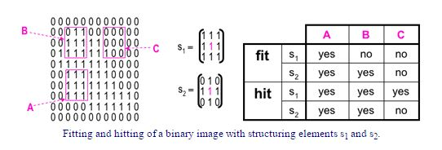
Fitting, Hitting and Missing of mask

Slide 35
Setting Example for Dilation
Suppose that the structuring element is a 3×3 square .
Note that in subsequent diagrams, foreground pixels are represented by 1's and background pixels by 0's.
To compute the dilation of a binary input image by this Structuring Element (SE), we superimpose the structuring element on top of the input image so that the origin of the structuring element coincides with the input pixel position.

Slide 36
Place the SE (origin) on the entire image pixel by pixel.
If the SE results “miss” condition do nothing.
If the SE “hits” or “fits” then the input pixel is set to the foreground value (0 to 1)
1
1
1
1
1
1
1
1
1
Structuring element

Slide 37
Dilation is typically applied to binary image, but there are versions that work on gray scale image.
The basic effect of the operator on a binary image is to gradually enlarge the boundaries of regions of foreground pixels (i.e. white pixels, typically).
Thus areas of foreground pixels grow in size while holes within those regions become smaller.

Slide 38
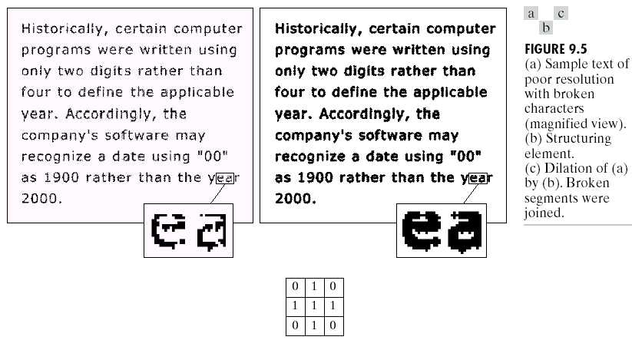
The basic effect of the operator on a binary image is to gradually enlarge the boundaries of regions of foreground pixels .

Slide 39

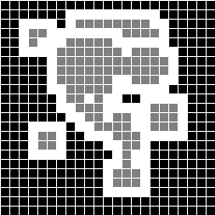
Explanation of Dilation
Dilation : x = (x₁,x₂) such that if we center B on them, then the so translated B intersects X.
X
difference
dilation
B

Slide 40
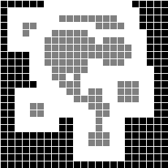
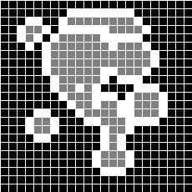


Dilation with other structuring elements

Slide 41
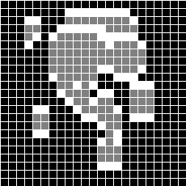



Dilation with other structuring elements

Slide 42
Dilation vs SE
Dilation expands binary regions
Can be used to fill in gaps or cracks in binary images
structuring Element ( SE )

Slide 43
Dilation fill holes
Fills in holes.
Smoothes object boundaries.
Adds an extra outer ring of pixels onto object boundary, ie, object becomes slightly larger.

Slide 44
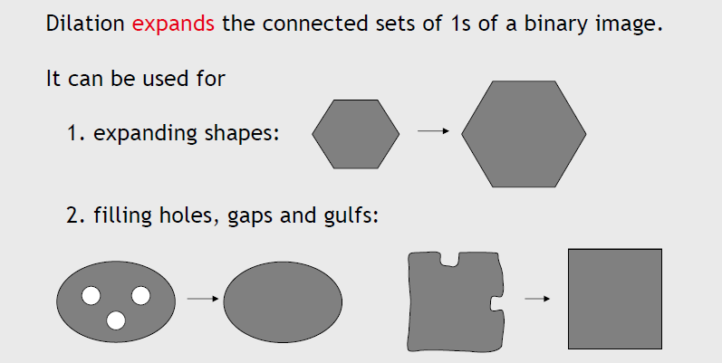
Main Applications of Dilation

Slide 45
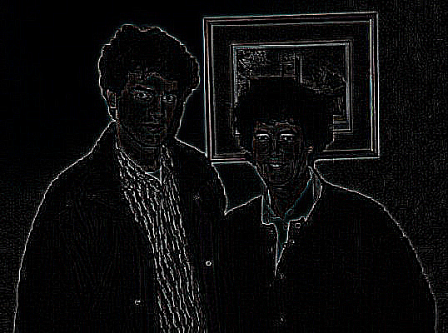
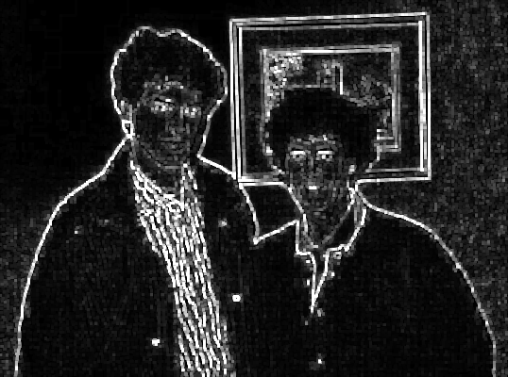
Dilation example

Slide 46
Possible problems with Morphological Operators
Erosion and dilation clean image but leave objects either smaller or larger than their original size.
Opening and closing perform same functions as erosion and dilation but object size remains the same.

Slide 47



More Erode and Dilate Examples
Input Image
Dilated
Eroded

Slide 48
Properties of Dilation
Dilation does the following:
1. fills in valleys between spiky regions
2. increases geometrical area of object
3. sets background pixels adjacent to object's contour to object's value
4. smoothes small negative grey level regions

Slide 49
Properties of Dilation
Commutative
Associative
Linearity

Slide 50
Erosion

Slide 51
Erosion
Erosion shrinks objects by etching away (eroding) their boundaries.
Performance:
1) If the origin of the structuring element coincides with a ‘0’ in the image, there is no change; move to the next pixel.
2) If the origin of the structuring element coincides with a ‘1’ in the image, and any of the ‘1’ pixels in the structuring element extend beyond the object (‘1’ pixels) in the image, then change the ‘1’ pixel in the image to a ‘0’;

Slide 52
Erosion
Erosion is the morphological dual to dilation. It combines two sets using the vector subtraction of set elements.
Let denotes the erosion of A by B

Slide 53
Erosion
B
A

Slide 54
Erosion

Slide 55

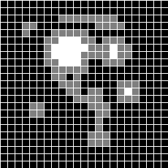
Example of Erosion
Erosion : x = (x₁,x₂) such that if we center B on them, then the so translated B is contained in X.
difference
erosion

Slide 56
Algorithm for Erosion
If the SE fits on the image do nothing.
If the SE miss on the image do nothing.
If the SE hits then the foreground pixel is set to the background value (1 to 0).

Slide 57
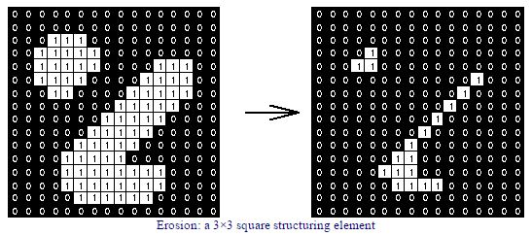

Slide 58
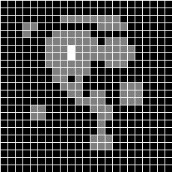
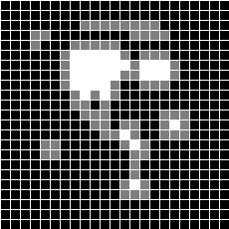
Erosion with other structuring elements

Slide 59
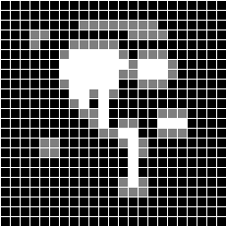
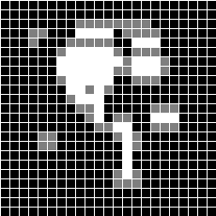
Erosion with other structuring elements
Did not belong to X
⊆
⊇
When the new SE is included in old SE then a larger area is created

Slide 60
More on Erosion

Slide 61
Erosion
(Minkowski subtraction)
The contraction of a binary region (aka, region shrinking)
Use a structuring element on binary image data to produce a new binary image
Structuring elements (SE) are simply patterns that are matched in the image
It is useful to explain operation of erosion and dilation in different ways.

Slide 62
Typical Uses of Erosion
Removes isolated noisy pixels.
Smoothes object boundary.
Removes the outer layer of object pixels, ie, object becomes slightly smaller.

Slide 63
Properties of Erosion:
Erosion removes spiky edges
objects are light (white in binary)
decreases geometrical area of object
sets contour pixels of object to background value
smoothes small positive grey level regions

Slide 64
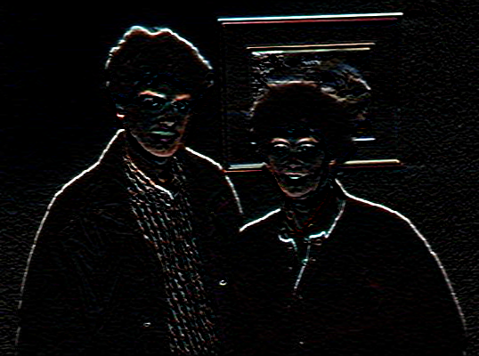
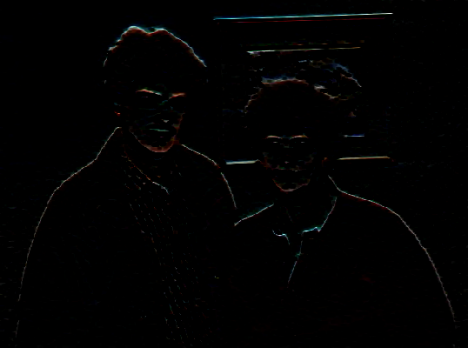
Erosion Example

Slide 65
How It Works?
During erosion, a pixel is turned on at the image pixel under the structuring element origin only when the pixels of the structuring element match the pixels in the image

Slide 66
Properties of Erosion
Erosion is not commutative!
Extensivity
Erosion is dereasing
Chain rule
The chain rule is as sharp operator in Cube Calculus used in logic synthesis. There are more similarities of these algebras

Slide 67
Opening
Opening consists of an erosion followed by a dilation and can be used to eliminate all pixels in regions that are too small to contain the structuring element.
In this case the structuring element is often called a probe, because it is probing the image looking for small objects to filter out of the image.

Slide 68


Matlab programming--- opening
original image
Image after opening

Slide 69
Closing
Closing consists of a dilation followed by an erosion and connects objects that are close to each other. It can be used to fill in holes and small gaps.

Slide 70

Matlab programming ---closing
original image (above)
Image after closing (below)

Slide 71
Iterative Morphological Operations
We can apply one or several operations to an image iteratively.
InputImage ---(apply an operation)→ outputImage1
---(apply the operation again)→ outputImage2
…and so on…..until get your desired image

Slide 72



Matlab program iterative operation of dilation
Original image after 1 dilation
After 5th dilations after infinite dilations

Slide 73



Matlab program iterative operation of erosion (1)
Original image after 1 erosion
after 5th erosions after inf erosions

Slide 74




Matlab program iterative operation of erosion (2)
Original image after 1 erosion
after 5th erosions after inf erosions

Slide 75

Matlab program iterative operation of opening (1)
Original image after 1 opening
after 5th openings after inf openings

Slide 76

Matlab program iterative operation of opening (2)
Original image after 1 opening
after 5th openings after inf openings

Slide 77

Matlab program iterative operation of closing (1)
Original image after 1 closing
after 5th closings after inf closnings

Slide 78

Matlab program iterative operation of closing (2)
Original image after 1 closing
after 5th closings after inf closings

Slide 79
Edge detection or Binary Contour

Slide 80
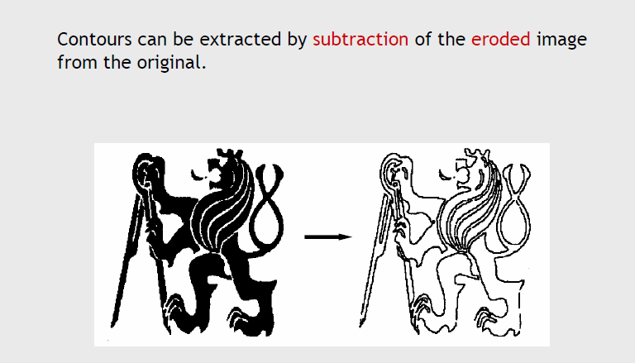
Boundary Extraction

Slide 81
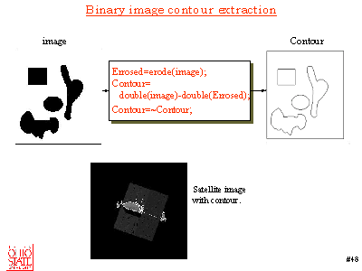
Erode and Binary Contour in Matlab
Erosion can be used to find contour

Slide 82
Opening & Closing
Opening and Closing are two important operators from mathematical morphology
They are both derived from the fundamental operations of erosion and dilation
They are normally applied to binary images

Slide 83





Open and Close
Close = Dilate next Erode
Open = Erode next Dilate
Original image
eroded
dilated
dilated
eroded
Open
Close

Slide 84
OPENING

Slide 85
Open
An erosion followed by a dilation
It serves to eliminate noise
Does not significantly change an object’s size

Slide 86
Comparison of Opening and Erosion
Opening is defined as an erosion followed by a dilation using the same structuring element
The basic effect of an opening is similar to erosion
Tends to remove some of the foreground pixels from the edges of regions of foreground pixels
Less destructive than erosion
The exact operation is determined by a structuring element.

Slide 87
Opening Example
What combination of erosion and dilation gives:
cleaned binary image
object is the same size as in original
Original

Slide 88
Opening Example Cont
Erode original image.
Dilate eroded image.
Smooths object boundaries, eliminates noise (isolated pixels) and maintains object size.
Original
Erode
Dilate

Slide 89
CLOSING

Slide 90
Close
Dilation followed by erosion
Serves to close up cracks in objects and holes due to pepper noise
Does not significantly change object size

Slide 91
More examples of Closing
What combination of erosion and dilation gives:
cleaned binary image
object is the same size as in original
Original

Slide 92
More examples of Closing cont
Dilate original image.
Erode dilated image.
Smooths object boundaries, eliminates noise (holes) and maintains object size.
Original
Dilate
Erode

Slide 93
Closing as dual to Opening
Closing, like its dual operator opening, is derived from the fundamental operations of erosion and dilation.
Normally applied to binary images
Tends to enlarge the boundaries of foreground regions
Less destructive of the original boundary shape
The exact operation is determined by a structuring element.

Slide 94
Closing is opening in revers
Closing is opening performed in reverse.
It is defined simply as a dilation followed by an erosion using the same

Slide 95
Morphological Filtering

Slide 96
Morphological Filtering
Main idea of Morphological Filtering:
Examine the geometrical structure of an image by matching it with small patterns called structuring elements at various locations
By varying the size and shape of the matching patterns, we can extract useful information about the shape of the different parts of the image and their interrelations.
Combine set-theoretical and morphological operations:

Slide 97
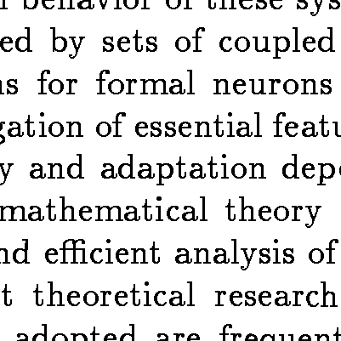
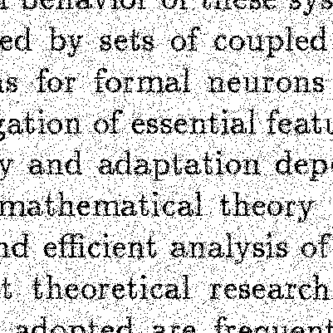
Example 1: Morphological filtering
Noisy image will break down (Optical Character Recognition) OCR systems
Clean original image
Noisy image

Slide 98
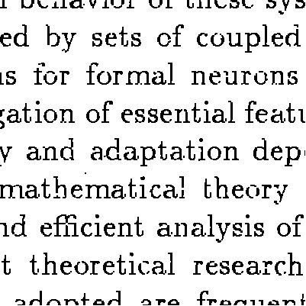
Morphological filtering (MF)
By applying MF, we increase the OCR accuracy!
Restored image

Slide 99
Postprocessing
Opening followed by closing.
Removes noise and smoothes boundaries.

Slide 100
Postprocessing
Result

Slide 101
Summary on Morphological Approaches
Mathematical morphology is an approach for processing digital image based on its shape
The language of morphology is set theory
The basic morphological operations are erosion and dilation
Morphological filtering can be developed to extract useful shape information
Methods can be extended to more values and more dimensions
Nice mathematics can be formulated - non-linear

Slide 102
Conclusion
Postprocessing uses morphological operators.
Same as convolution only use Boolean operators instead of multiply and add.
Erosion clears noise, makes smaller.
Dilation fills in holes, makes larger.
Postprocessing
Opening and closing to clean binary images.
Repeated erosion with special rule produces skeleton.

